Slide 1
Employee salary using excel
STUDENT NAME : S. SATHYA
REGISTER NO: 312200934
DEPARTMENT:B.COM(COMPUTER APPLICATION)
COLLEGE :PACHAIYAPPA’S COLLEGE FOR WOMEN, KANCHIPURAM.
Notes:
This template can be used as a starter file for presenting training materials in a group setting.
Sections
Right-click on a slide to add sections. Sections can help to organize your slides or facilitate collaboration between multiple authors.
Notes
Use the Notes section for delivery notes or to provide additional details for the audience. View these notes in Presentation View during your presentation.
Keep in mind the font size (important for accessibility, visibility, videotaping, and online production)
Coordinated colors
Pay particular attention to the graphs, charts, and text boxes.
Consider that attendees will print in black and white or grayscale. Run a test print to make sure your colors work when printed in pure black and white and grayscale.
Graphics, tables, and graphs
Keep it simple: If possible, use consistent, non-distracting styles and colors.
Label all graphs and tables.

Slide 2
PROJECT TITLE
EMPLOYEE SALARY AND COMPENSATION ANALYSIS THROUGH EXCEL DATA MODELING
Notes:
Give a brief overview of the presentation. Describe the major focus of the presentation and why it is important.
Introduce each of the major topics.
To provide a road map for the audience, you can repeat this Overview slide throughout the presentation, highlighting the particular topic you will discuss next.

Slide 3

AGENDA
PROBLEM STATEMENT
PROJECT OVERVIEW
SALARY PROCESS
OUR SOLUTIONS AND PROPOSITION
DATASET DESCRIPTION
MODELING APPROACH
RESULTS AND DISCUSSION
CONCLUSION
Notes:
This is another option for an Overview slides using transitions.

Slide 4
PROBLEM STATEMENT
Employee salaries can be affected by a range of issues, including inaccurate calculations, late or missed payments, incorrect deductions, and unfair compensation. Misclassification, overtime or hours issues, benefits discrepancies, and tax compliance problems can also arise. Additionally, salary advances or loans, communication breakdowns, pay equity concerns, performance-based pay disputes, payroll system errors, and non-compliance with regulations can impact employee salaries. Furthermore, salary freezes or reductions can cause concern among employees. It is essential for organizations to address these issues promptly and transparently to maintain employee trust, morale, and productivity.

Slide 5

PROJECT OVERVIEW
Employees Salary Statement Analysis To Review Though Employers Must Issue Salary Slips To Their Employees, It Is Not Mandatory To Provide Printed Slips. For Employees, A Salary Slip Works As Proof Of Income. It Provide The Detail Statements Of Expenses On Management

Slide 6

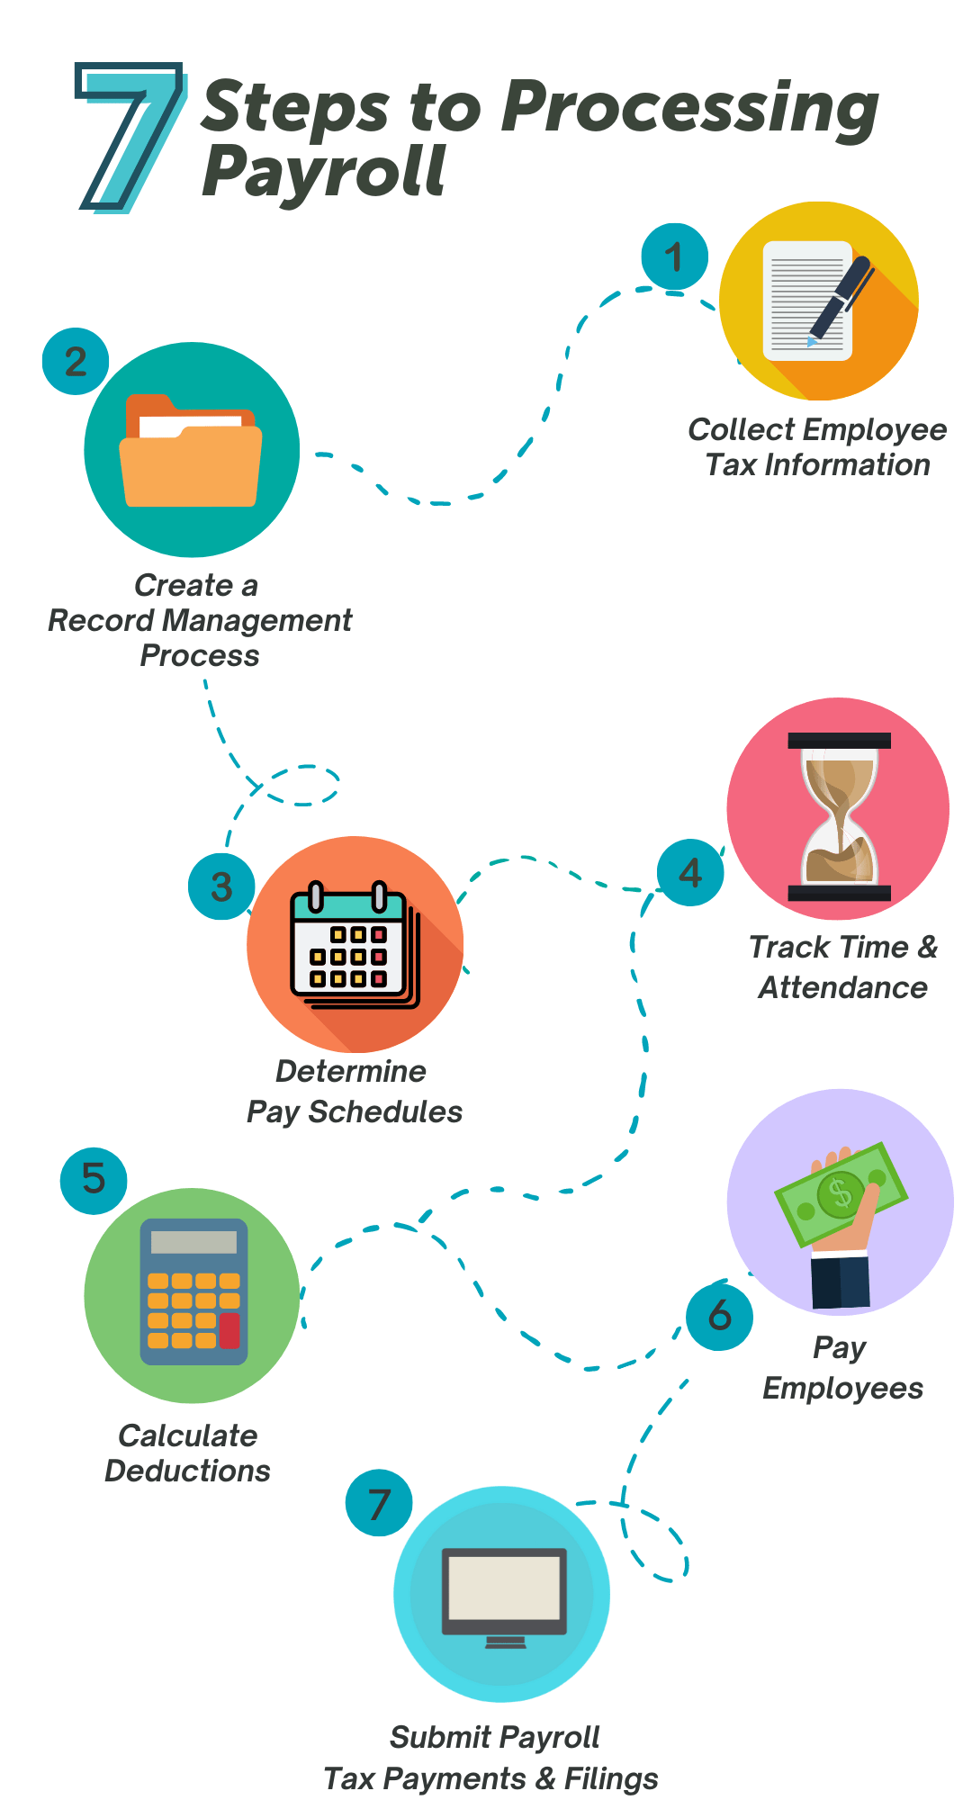

Salary process
Welcome

Slide 7
OUR SOLUTION AND ITS VALUE PROPOSITION
conditional formatting – missing values
filter-filter out missing values
pivot table- summary of data
graph- data visualization

Slide 8
DATA SET DESCRIPTION Employee Data Set Total employees - 20 Provident Fund-numerical D.A- Numerical T.A - Numerical Gross Salary- Numerical Net Salary- Numerical
Notes:
What will the audience be able to do after this training is complete? Briefly describe each objective how the audience will benefit from this presentation.

Slide 9
MODELLING
DATA COOLLECTION
1. Download kaggle
2. Edunet dashboard- file download
FEATURES COLLECTION
1.Employees name
2.Basic salary
3.Dearness allowance
4.Travelling allowance
5.Gross salary
6.Provident fund
7.Net salary
USING PIVOT TABLE GRAPH FOR SUMMARY
Notes:
Use a section header for each of the topics, so there is a clear transition to the audience.

Slide 10
RESULT

Slide 11
CONCLUSION
The Salary Statement Provides A Clear Breakdown Of The Employee’s Total Earnings, Including Basic Pay, Allowances And Bonuses, Along Side Statutory And Other Deduction.
The Net Salary Payable Is Calculated After On Applicable Deductions.
This Statement Ensures Transparency And Accuracy In Salary Disbursement Supporting Both The Employee And Employer In Financial Planning.

Slide 12
THANK YOU
Notes:
Is your presentation as crisp as possible? Consider moving extra content to the appendix.
Use appendix slides to store content that you might want to refer to during the Question slide or that may be useful for attendees to investigate deeper in the future.

